Slide 1
Python BOTO3 functions
AWS

Slide 2
Python Boto3
AWS SDK for Python (Boto3)
Boto3 ,the AWS SDK for Python. It is used to integrate Python application, library, or script with AWS services including Amazon S3, Amazon EC2, Amazon DynamoDB, and more.
https://boto3.amazonaws.com/
Above URL has all the required information which and how to use AWS services using boto3

Slide 3
Example
Import boto3
To start with particular service:
S3_client = boto3.client(‘s3’)
ec2_client = boto3.client(‘ec2’)
iam_client = boto3.client(‘iam’)

Slide 4
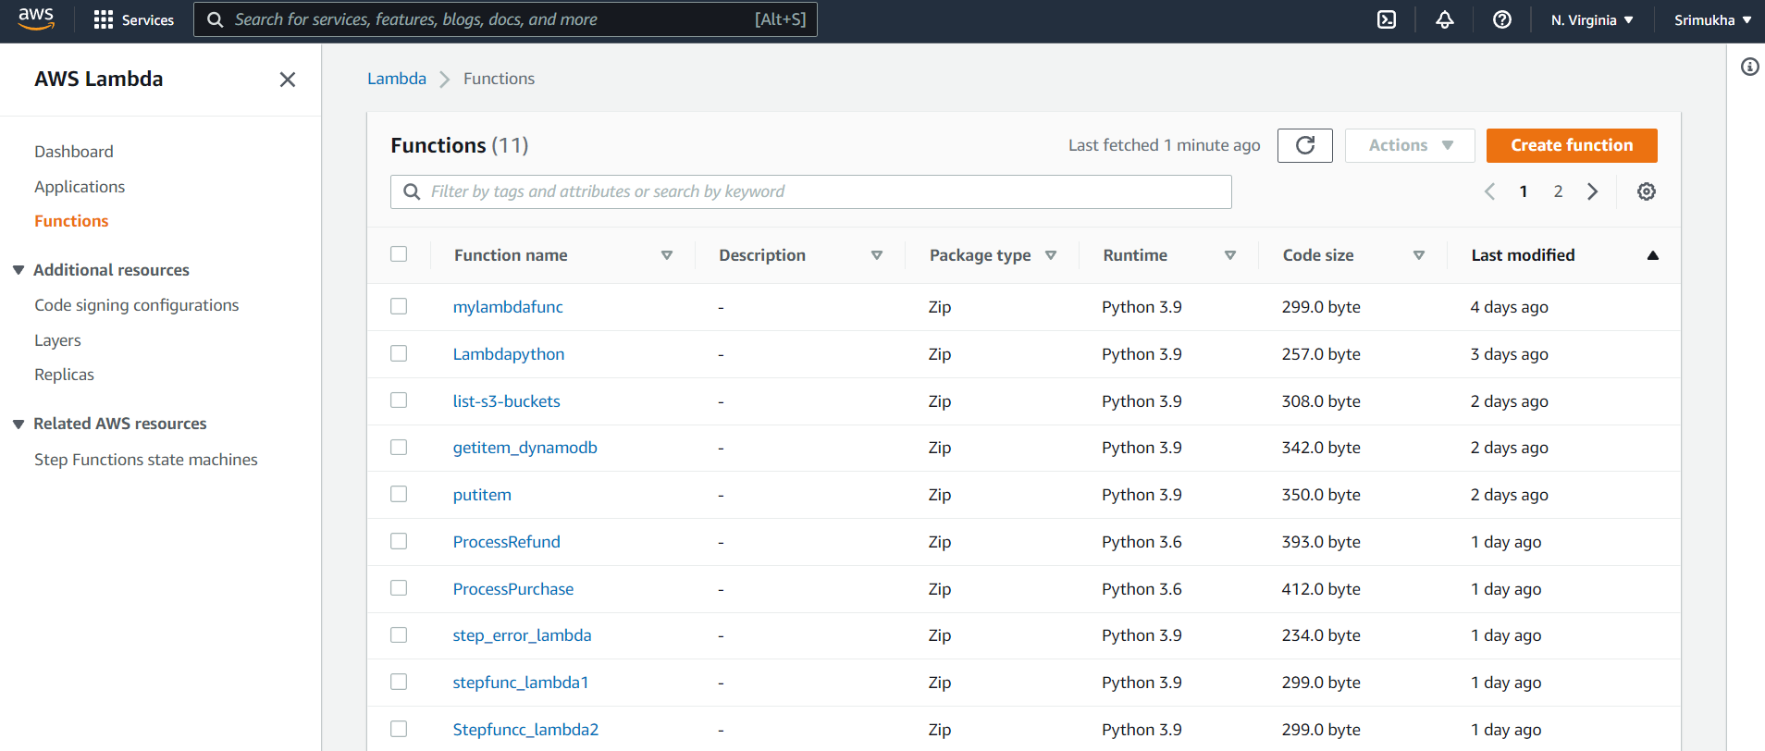
Created Lambda functions and selected python as language

Slide 5
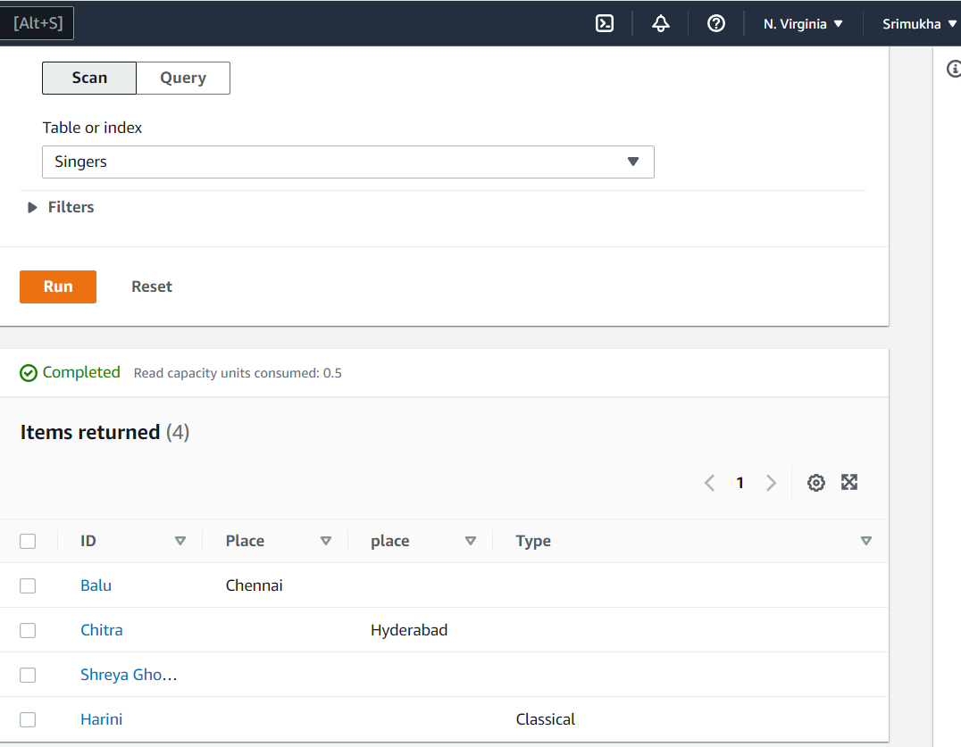
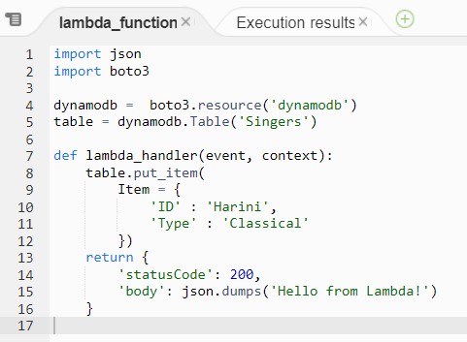
Put_Item in dynamoDB
Code
Result

Slide 6
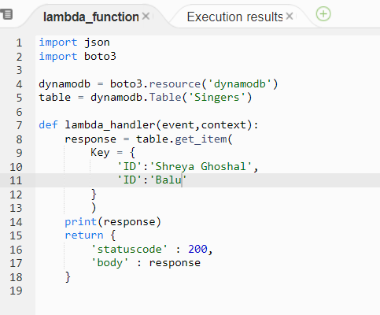
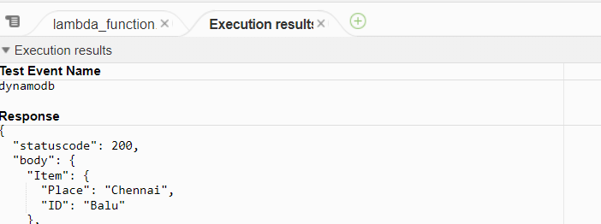
getitem_dynamodb
Code
Result

Slide 7
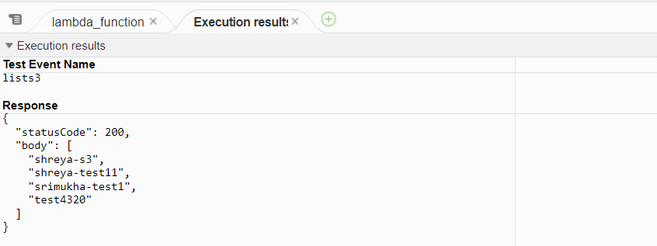
List buckets in S3
import json
import boto3
s3 = boto3.resource('s3’)
def lambda_handler(event,context): bucket_list = []
for bucket in s3.buckets.all(): print(bucket.name) bucket_list.append(bucket.name)
return { 'statusCode' : 200, 'body' : bucket_list }

